Slide 1
Basic Network Programming concepts

Slide 2
Synthesis: a day in the life of a web request
our journey down the protocol stack is now complete!
  application, transport, network, link
putting-it-all-together: synthesis!
  goal: identify, review, understand protocols (at all layers) involved in seemingly simple scenario: requesting www page
  scenario: student attaches laptop to campus network, requests/receives www.google.com

Slide 3
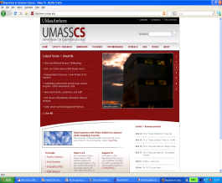



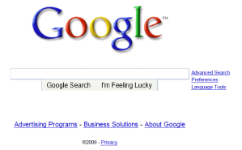
A day in the life: scenario
scenario:
DNS server
arriving mobile client attaches to network …
browser
Comcast network
68.80.0.0/13
requests web page: www.google.com
school network
68.80.2.0/24
web page
Sounds
simple!
web server
Google’s network
64.233.160.0/19
64.233.169.105

Slide 4
A day in the life: connecting to the Internet
DHCP
DHCP
UDP
IP
Eth
Phy
connecting laptop needs to get its own IP address, addr of first-hop router, addr of DNS server: use DHCP
DHCP
DHCP
DHCP
arriving mobile:
DHCP client
DHCP
DHCP request encapsulated in UDP, encapsulated in IP, encapsulated in 802.3 Ethernet
DHCP
DHCP
UDP
IP
Eth
Phy
DHCP
DHCP
DHCP
DHCP
Ethernet frame broadcast (dest: FFFFFFFFFFFF) on LAN, received at router running DHCP server
router has
DHCP server
Ethernet de-muxed to IP de-muxed, UDP de-muxed to DHCP

Slide 5

A day in the life: connecting to the Internet
DHCP
UDP
IP
Eth
Phy
DHCP server formulates DHCP ACK containing client’s IP address, IP address of first-hop router for client, name & IP address of DNS server
DHCP
DHCP
DHCP
arriving mobile:
DHCP client
DHCP
encapsulation at DHCP server, frame forwarded (switch learning) through LAN, demultiplexing at client
DHCP
DHCP
UDP
IP
Eth
Phy
DHCP
DHCP
DHCP
DHCP
router has
DHCP server
DHCP client receives DHCP ACK reply
Client now has IP address, knows name & addr of DNS
server, IP address of its first-hop router

Slide 6
A day in the life… ARP (before DNS, before HTTP)
DNS
DNS
UDP
IP
Eth
Phy
before sending HTTP request, need IP address of www.google.com: DNS
DNS
DNS
ARP
ARP query
arriving mobile:
ARP client
DNS query created, encapsulated in UDP, encapsulated in IP, encapsulated in Eth. To send frame to router, need MAC address of router interface: ARP
ARP
ARP query broadcast, received by router, which replies with ARP reply giving MAC address of router interface
ARP reply
Eth
Phy
router has
ARP server
client now knows MAC address of first hop router, so can now send frame containing DNS query

Slide 7
A day in the life… using DNS
DNS
DNS
DNS
DNS
DNS
DNS
UDP
IP
Eth
Phy
de-muxed to DNS
DNS replies to client with IP address of www.google.com
DNS
DNS
UDP
IP
Eth
Phy
DNS
DNS
DNS
DNS
DNS
DNS
server
DNS
DNS
Comcast network
68.80.0.0/13
IP datagram containing DNS query forwarded via LAN switch from client to 1st hop router
IP datagram forwarded from campus network into Comcast network, routed (tables created by RIP, OSPF, IS-IS and/or BGP routing protocols) to DNS server

Slide 8
A day in the life…TCP connection carrying HTTP
DNS
DNS
DNS
HTTP
HTTP
TCP
IP
Eth
Phy
to send HTTP request, client first opens TCP socket to web server
SYNACK
SYN
SYNACK
SYN
SYNACK
SYN
SYN
Comcast network
68.80.0.0/13
TCP SYN segment (step 1 in TCP 3-way handshake) inter-domain routed to web server
TCP
IP
Eth
Phy
web server responds with TCP SYNACK (step 2 in TCP 3-way handshake)
SYNACK
SYN
SYNACK
SYN
SYNACK
SYNACK
SYN
TCP connection established!
Google web server
64.233.169.105

Slide 9
A day in the life… HTTP request/reply
DNS
DNS
DNS
HTTP
HTTP
TCP
IP
Eth
Phy
HTTP
HTTP
HTTP
web page finally (!!!) displayed
HTTP
HTTP
HTTP
HTTP
HTTP
Comcast network
68.80.0.0/13
HTTP
HTTP
TCP
IP
Eth
Phy
HTTP
HTTP
HTTP
HTTP
Google web server
64.233.169.105

Slide 10

What is a network program / application?
The apps are classified broadly into 2 kinds:
Client applications request information
Server applications respond to information requests from clients
The client app makes a request by identifying the requested Internet resource and the communication protocol
If necessary, the client also provides any additional data required:
proxy location
authentication information
Notes:
---------------------------------
Lập trình web là xây dựng websites và ứng dụng web có thể dùng với bất kì trình duyệt.
Trình duyệt được viết dựa vào lập trình mạng, kết nối tới web server, web server lắng nghe port 80 và chờ kết nối đến.
Lập trình mạng là cách viết ứng dụng giao tiếp với ứng dụng qua mạng.

Slide 11
Some network apps
social networking
Web
text messaging
e-mail
multi-user network games
streaming stored video (YouTube, Hulu, Netflix)
P2P file sharing
voice over IP (e.g., Skype)
real-time video conferencing (e.g., Zoom)
Internet search
remote login
…
Q: your favorites?

Slide 12













Creating a network app
application
transport
network
data link
physical
write programs that:
run on (different) end systems
communicate over network
e.g., web server software communicates with browser software
no need to write software for network-core devices
network-core devices do not run user applications
applications on end systems allows for rapid app development, propagation
mobile network
national or global ISP
local or regional ISP
home network
content
provider
network
application
transport
network
data link
physical
application
transport
network
data link
physical
datacenter
network
enterprise
network

Slide 13
Client-server paradigm
server:
always-on host
permanent IP address
often in data centers, for scaling
clients:
contact, communicate with server
may be intermittently connected
may have dynamic IP addresses
do not communicate directly with each other
examples: HTTP, IMAP, FTP
mobile network
national or global ISP
local or regional ISP
home network
content
provider
network
datacenter
network
enterprise
network
Notes:
Intermittently: không liên tục

Slide 14
Peer-peer architecture
no always-on server
arbitrary end systems directly communicate
peers request service from other peers, provide service in return to other peers
  self scalability – new peers bring new service capacity, as well as new service demands
peers are intermittently connected and change IP addresses
  complex management
example: P2P file sharing [BitTorrent]
mobile network
national or global ISP
local or regional ISP
home network
content
provider
network
datacenter
network
enterprise
network

Slide 15
Processes communicating
process: program running within a host
within same host, two processes communicate using inter-process communication (defined by OS)
processes in different hosts communicate by exchanging messages
clients, servers
client process: process that initiates communication
server process: process that waits to be contacted
note: applications with P2P architectures have client processes & server processes

Slide 16

Sockets
process sends/receives messages to/from its socket
socket analogous to door
  sending process shoves message out door
  sending process relies on transport infrastructure on other side of door to deliver message to socket at receiving process
  two sockets involved: one on each side
application
socket
application
controlled by
app developer
process
process
transport
transport
network
network
controlled
by OS
link
Internet
link
physical
physical

Slide 17
Addressing processes
to receive messages, process must have identifier
host device has unique 32-bit IP address
Q: does IP address of host on which process runs suffice for identifying the process?
identifier includes both IP address and port numbers associated with process on host.
example port numbers:
  HTTP server: 80
  mail server: 25
to send HTTP message to gaia.cs.umass.edu web server:
  IP address: 128.119.245.12
  port number: 80
more shortly…
  A: no, many processes can be running on same host

Slide 18
Protocol “layers” and reference models
Networks are complex,
with many “pieces”:
  hosts
  routers
  links of various media
  applications
  protocols
  hardware, software
Question: is there any hope of organizing structure of network?
and/or our discussion of networks?

Slide 19
What’s a protocol?
Human protocols:
“what’s the time?”
“I have a question”
introductions
Network protocols:
computers (devices) rather than humans
all communication activity in Internet governed by protocols
Rules for:
… specific messages sent
… specific actions taken when message received, or other events
Protocols define the format, order of messages sent and received among network entities, and actions taken on message transmission, receipt

Slide 20


What’s a protocol?
A human protocol and a computer network protocol:
Hi
TCP connection
request
Hi
TCP connection
response
Got the
time?
GET http://gaia.cs.umass.edu/kurose_ross
2:00
<file>
time
Q: other human protocols?
Notes:
Explain important points
distributed entities, exchanging messages (governed by protocols)
Time going down
go over definition of protocol (showing format, order of messages sent and received, and actions taken)
We’ll see these kinds of diagrams a lot
1. Handshaking Protocol (TCP 3-Way Handshake)
Human Protocol Example: When two people meet, they usually engage in a simple protocol for greeting. One person says, “Hello” (SYN), the other person responds with “Hello, nice to meet you” (SYN-ACK), and the first person replies with “Nice to meet you too” (ACK). After this exchange, they start the conversation.
Computer Network Example: In the TCP 3-way handshake, a client sends a SYN packet to initiate a connection. The server responds with a SYN-ACK packet. Finally, the client sends an ACK packet to acknowledge the connection, and data transmission begins.
2. Addressing (IP Addressing)
Human Protocol Example: Sending a physical letter. To make sure the letter gets to the correct person, you need to write the recipient’s postal address. The address ensures the letter arrives at the right location.
Computer Network Example: IP addressing works similarly. Every computer or device on a network has an IP address, which serves as its unique identifier, just like a home address in the real world. When a message (data packet) is sent, it is directed to the correct destination using the IP address.
3. Flow Control (Speaking Etiquette)
Human Protocol Example: In a conversation, people don’t speak at the same time, and they take turns to talk. If one person talks too fast or for too long without pausing, the other person may not be able to keep up or respond appropriately.
Computer Network Example: Flow control in networking is similar. In protocols like TCP, flow control ensures that the sender does not overwhelm the receiver with too much data at once. It helps balance the rate at which data is sent and received.
4. Error Checking (Feedback in Communication)
Human Protocol Example: If you’re talking on the phone and the line is bad, you may ask the other person, "Can you repeat that?" to make sure you understood them correctly. This is an example of error checking, where you confirm that the message was correctly received.
Computer Network Example: Error detection and correction mechanisms like checksums or parity checks ensure that data transmitted across a network is correct. If an error is detected, the receiver can request the data to be sent again.
5. Routing (Giving Directions)
Human Protocol Example: Imagine you're asking for directions to a destination. A person might tell you to take multiple turns: “Go straight for 2 miles, turn left, then take a right at the traffic light.” These directions ensure that you reach your destination efficiently.
Computer Network Example: In networking, routers perform this function. Data packets travel across multiple networks, and routers direct these packets based on the best path, similar to giving directions on how to reach a destination.
6. HTTP Protocol (Requesting Information in a Restaurant)
Human Protocol Example: In a restaurant, a waiter asks what you’d like to order. You make a specific request (e.g., “I’d like a cheeseburger”), and the waiter goes to the kitchen and brings the requested item to you.
Computer Network Example: In HTTP (Hypertext Transfer Protocol), your browser (client) makes a request to a web server for a webpage or resource. The server processes the request and sends the requested page back to your browser.
7. DNS (Directory Assistance or Phonebook)
Human Protocol Example: If you want to call someone but don't know their phone number, you might look them up in a phonebook or use directory assistance to get their number.
Computer Network Example: In the internet, DNS (Domain Name System) works similarly. It translates human-readable domain names (like www.example.com) into IP addresses that computers use to identify each other on the network.
8. Authentication (Checking ID at an Event)
Human Protocol Example: When you attend a private event, the host might ask for your invitation or ID to confirm you are allowed to enter.
Computer Network Example: Authentication protocols, such as those used by websites requiring a username and password, verify the identity of users before granting them access to certain resources.
9. Broadcasting (Announcement to a Group)
Human Protocol Example: A teacher making an announcement to the entire class is an example of broadcasting. Everyone in the room hears the same message at the same time.
Computer Network Example: In networking, broadcasting refers to sending data to all devices on a network segment, where every device receives the same message.

Slide 21
Layered Internet protocol stack
application: supporting network applications
  HTTP, IMAP, SMTP, DNS
transport: process-process data transfer
  TCP, UDP
network: routing of datagrams from source to destination
  IP, routing protocols
link: data transfer between neighboring network elements
  Ethernet, 802.11 (WiFi), PPP
physical: bits “on the wire”
application
application
transport
transport
network
network
link
link
physical
physical

Slide 22
Why layering?
Approach to designing/discussing complex systems:
explicit structure allows identification, relationship of system’s pieces
  layered reference model for discussion
modularization eases maintenance, updating of system
  change in layer's service implementation: transparent to rest of system
  e.g., change in gate procedure doesn’t affect rest of system

Slide 23
Example: organization of air travel
end-to-end transfer of person plus baggage
ticket (purchase)
baggage (check)
gates (load)
runway takeoff
airplane routing
ticket (complain)
baggage (claim)
gates (unload)
runway landing
airplane routing
airplane routing
How would you define/discuss the system of airline travel?
a series of steps, involving many services

Slide 24
Services, Layering and Encapsulation
application
transport
network
link
physical
M
application
transport
network
link
physical
Application exchanges messages to implement some application service using services of transport layer
H_{t}
M
Transport-layer protocol transfers M (e.g., reliably) from one process to another, using services of network layer
transport-layer protocol encapsulates application-layer message, M, with transport layer-layer header H_{t} to create a transport-layer segment
  H_{t} used by transport layer protocol to implement its service
source
destination

Slide 25
Services, Layering and Encapsulation
application
transport
network
link
physical
M
application
transport
network
link
physical
H_{t}
M
Transport-layer protocol transfers M (e.g., reliably) from one process to another, using services of network layer
H_{n}
H_{t}
M
Network-layer protocol transfers transport-layer segment [H_{t} | M] from one host to another, using link layer services
network-layer protocol encapsulates transport-layer segment [H_{t} | M] with network layer-layer header H_{n} to create a network-layer datagram
  H_{n} used by network layer protocol to implement its service
source
destination

Slide 26
Services, Layering and Encapsulation
H_{n}
H_{t}
M
application
transport
network
link
physical
M
application
transport
network
link
physical
H_{t}
M
H_{n}
H_{t}
M
Network-layer protocol transfers transport-layer segment [H_{t} | M] from one host to another, using link layer services
H_{l}
H_{n}
H_{t}
M
Link-layer protocol transfers datagram [H_{n}| [H_{t} |M] from host to neighboring host, using network-layer services
link-layer protocol encapsulates network datagram [H_{n}| [H_{t} |M], with link-layer header H_{l} to create a link-layer frame
source
destination

Slide 27





Encapsulation
Matryoshka dolls (stacking dolls)
message
segment
datagram
frame
Credit: https://dribbble.com/shots/7182188-Babushka-Boi
Notes:
Thanks to Nikko Bovornkeeratiroj, Phuthipong <phuthipong@cs.umass.edu>, for the stacking dolls idea and slides

Slide 28
Services, Layering and Encapsulation
application
transport
network
link
physical
application
transport
network
link
physical
message
M
M
segment
H_{t}
M
H_{t}
M
datagram
H_{n}
H_{t}
M
H_{n}
H_{t}
M
frame
H_{l}
H_{n}
H_{t}
M
H_{l}
H_{n}
H_{t}
M
source
destination

Slide 29
Encapsulation: an end-end view
source
message
M
application
transport
network
link
physical
segment
H_{t}
M
H_{t}
datagram
H_{n}
H_{t}
H_{n}
M
frame
H_{l}
H_{n}
H_{t}
M
link
physical
switch
destination
H_{n}
H_{t}
M
network
link
physical
M
application
transport
network
link
physical
H_{l}
H_{n}
H_{t}
M
H_{n}
H_{t}
M
H_{t}
M
H_{n}
H_{t}
M
H_{l}
H_{n}
H_{t}
M
router

Slide 30
ISO/OSI reference model
Two layers not found in Internet protocol stack!
presentation: allow applications to interpret meaning of data, e.g., encryption, compression, machine-specific conventions
session: synchronization, checkpointing, recovery of data exchange
Internet stack “missing” these layers!
  these services, if needed, must be implemented in application
  needed?
application
presentation
session
transport
network
link
physical
The seven layer OSI/ISO
reference model

Slide 31
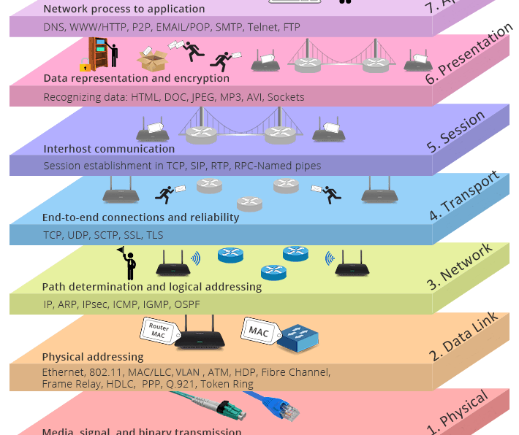
1. OSI layer model
The most popular layer system for networking is called the Open Systems Interconnection model (OSI model).
It was standardized in 1977 and is published as ISO 7498.
It has 7 layers.
Notes:
Physical (1): This is the level of physical communication in the real world. At this level, we have specifications for things such as the voltage levels on an Ethernet cable, what each pin on a connector is for, the radio frequency of Wi-Fi, and the light flashes over an optic fiber. [Bit]
Data Link (2): This level builds on the physical layer. It deals with protocols for directly communicating between two nodes. It defines how a direct message between nodes starts and ends (framing), error detection and correction, and flow control. [Frame]
Network layer (3): The network layer provides the methods to transmit data sequences (called packets) between nodes in different networks. It provides methods to route packets from one node to another (without a direct physical connection) by transferring through many intermediate nodes. This is the layer that the Internet Protocol is defined on, which we will go into in some depth later. [Packet]
Transport layer (4): At this layer, we have methods to reliably deliver variable length data between hosts. These methods deal with splitting up data, recombining it, ensuring data arrives in order, and so on. The Transmission Control Protocol (TCP) and User Datagram Protocol (UDP) are commonly said to exist on this layer. [Segment (TCP) / Datagram (UDP)]
Session layer (5): This layer builds on the transport layer by adding methods to establish, checkpoint, suspend, resume, and terminate dialogs. [Data]
Presentation layer (6): This is the lowest layer at which data structure and presentation for an application are defined. Concerns such as data encoding, serialization, and encryption are handled here. [Data]
Application layer (7): The applications that the user interfaces with (for example, web browsers and email clients) exist here. These applications make use of the services provided by the six lower layers. [Data]
-----
Link: https://community.fs.com/article/tcpip-vs-osi-whats-the-difference-between-the-two-models.html

Slide 32
Services, Layering and Encapsulation
application
transport
network
link
physical
M
application
transport
network
link
physical
M
message
H_{t}
M
H_{t}
M
segment
H_{n}
H_{t}
M
H_{n}
H_{t}
M
datagram
H_{l}
H_{n}
H_{t}
M
H_{l}
H_{n}
H_{t}
M
frame
source
destination

Slide 33
Application layer: overview
Our goals:
conceptual and implementation aspects of application-layer protocols
  transport-layer service models
  client-server paradigm
  peer-to-peer paradigm
learn about protocols by examining popular application-layer protocols and infrastructure
  HTTP
  SMTP, IMAP
  DNS
  video streaming systems, CDNs
programming network applications
  socket API

Slide 34
An application-layer protocol defines:
types of messages exchanged,
  e.g., request, response
message syntax:
  what fields in messages & how fields are delineated
message semantics
  meaning of information in fields
rules for when and how processes send & respond to messages
open protocols:
defined in RFCs, everyone has access to protocol definition
allows for interoperability
e.g., HTTP, SMTP
proprietary protocols:
e.g., Skype, Zoom

Slide 35
What transport service does an app need?
data integrity
some apps (e.g., file transfer, web transactions) require 100% reliable data transfer
other apps (e.g., audio) can tolerate some loss
throughput
some apps (e.g., multimedia) require minimum amount of throughput to be “effective”
other apps (“elastic apps”) make use of whatever throughput they get
timing
some apps (e.g., Internet telephony, interactive games) require low delay to be “effective”
security
encryption, data integrity, …

Slide 36

Network Programming
Network Programming involves writing programs that communicate with other programs across a computer network.
Design network application:
Security
High performance
Scalability
Notes:
Lập trình mạng là các kỹ thuật lập trình nhằm xây dựng những ứng dụng, phần mềm khai thác hiệu quả tài nguyên mạng máy tính.

Slide 37
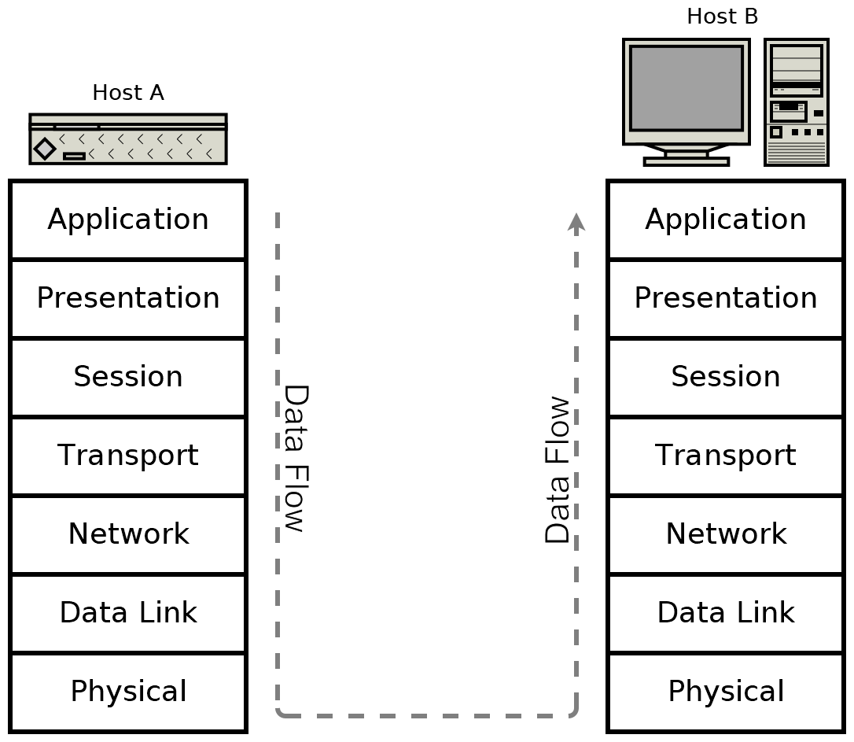
Data encapsulation
Lower levels are responsible for handling data for the higher levels → these lower-level data structures must encapsulate data from the higher levels.
→ when programming an application, only need to consider the highest-level protocol.
When communicating over a network, data must be processed down through the layers at the sender and up again through the layers at the receiver.
Notes:
0. Regardless of your chosen abstraction model, real-world protocols do work at many levels. Lower levels are responsible for handling data for the higher levels. These lower-level data structures must, therefore, encapsulate data from the higher levels. Let's look at encapsulating data now.
1. The advantage of these abstractions is that, when programming an application, we only need to consider the highest-level protocol.
For example, a web browser needs only to implement the protocols dealing specifically with websites—HTTP, HTML, CSS, and so on. It does not need to bother with implementing TCP/IP, and it certainly doesn't have to understand how an Ethernet or Wi-Fi packet is encoded. It can rely on ready-made implementations of the lower layers for these tasks. These implementations are provided by the operating system (for example, Windows, Linux, and macOS).
2. For example, if we have a web server, Host A, which is transmitting a web page to the receiver, Host B, it may look like this:

Slide 38
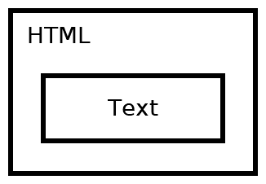
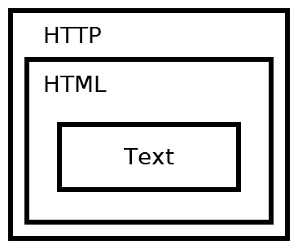
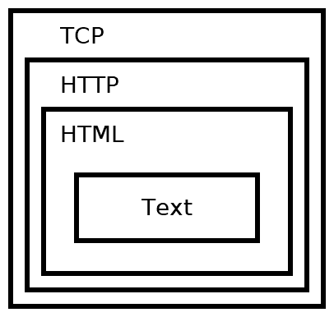
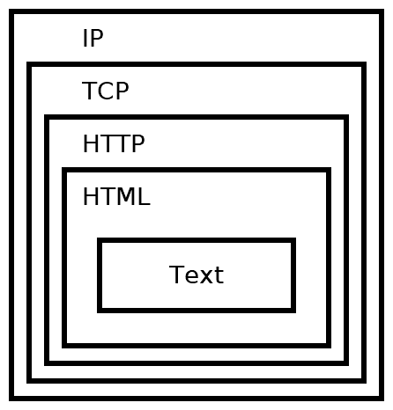
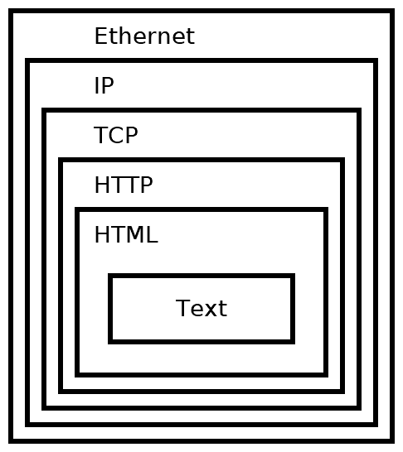
3. Data encapsulation
For example:
Notes:
1. The web page contains a few paragraphs of text, but the web server doesn't only send the text by itself. For the text to be rendered correctly, it must be encoded in an HTML structure.
2. As the text cannot be transmitted directly, neither can the HTML. It instead must be transmitted as part of an HTTP response. The web server does this by applying the appropriate HTTP response header to the HTML.
3. The HTTP is transmitted as part of a TCP session. This isn't done explicitly by the web server, but is taken care of by the operating system's TCP/IP stack.
4. The TCP packet is routed by an IP packet.
5. This is transmitted over the wire in an Ethernet packet (or another protocol).

Slide 39
4. Internet Protocol
One protocol is overwhelmingly common.
It comes in two versions—IPv4 and IPv6
IPv4:
IPv4 is completely ubiquitous and deployed everywhere.
IPv4 uses 32-bit addresses, which limits it to addressing no more than 2³² or 4,294,967,296 systems.
IPv6:
IPv6 was designed to replace IPv4
It uses a 128-bit address, 2¹²⁸ ≈ 3.4 x 10³⁸ addresses.
Notes:
Overwhelming: quá phổ biến
0. Luckily for us, the lower-level concerns are handled automatically when we use the socket APIs for network programming.
Without this knowledge, dealing with failures or optimizing for performance is difficult if not impossible. With some of the theory out of the way, let's dive into the actual protocols powering modern networking.
3. If you're deploying network code today, you must support IPv4 or risk that a significant portion of your users won't be able to connect.
Today, every major desktop and smartphone operating system supports both IPv4 and IPv6 in what is called a dual-stack configuration. However, many applications, servers, and networks are still only configured to use IPv4. From a practical standpoint, this means that you need to support IPv4 in order to access much of the internet. However, you should also support IPv6 to be future-proof and to help the world to transition away from IPv4.
---- Cloudflare
The Internet Protocol (IP) is a protocol, or set of rules, for routing and addressing packets of data so that they can travel across networks and arrive at the correct destination. Data traversing the Internet is divided into smaller pieces, called packets. IP information is attached to each packet, and this information helps routers to send packets to the right place. Every device or domain that connects to the Internet is assigned an IP address, and as packets are directed to the IP address attached to them, data arrives where it is needed.
Once the packets arrive at their destination, they are handled differently depending on which transport protocol is used in combination with IP. The most common transport protocols are TCP and UDP.

Slide 40
6. Domain names
The Internet Protocol can only route packets to an IP address.
If you try to connect to a website, your system must first resolve that domain name into an IP address for the server that hosts that website.
This is done by connecting to a Domain Name System (DNS) server. The IP address for a domain name server is usually assigned by your ISP.
Notes:
0. If you think that IPv4 addresses are difficult to memorize, and IPv6 addresses impossible, then you are not alone. Luckily, we have a system to assign names to specific addresses.
1. The Internet Protocol can only route packets to an IP address, not a name. So, if you try to connect to a website, such as example.com, your system must first resolve that domain name, example.com, into an IP address for the server that hosts that website.
2. This is done by connecting to a Domain Name System (DNS) server. You connect to a domain name server by knowing in advance its IP address. The IP address for a domain name server is usually assigned by your ISP.

Slide 41
6. Domain names
Free and public DNS servers
DNS Provider | IPv4 Addresses | IPv6 Addresses
Cloudflare 1.1.1.1 | 1.1.1.1 | 2606:4700:4700::1111
 | 1.0.0.1 | 2606:4700:4700::1001
FreeDNS | 37.235.1.174
 | 37.235.1.177
Google Public DNS | 8.8.8.8 | 2001:4860:4860::8888
 | 8.8.4.4 | 2001:4860:4860::8844
OpenDNS | 208.67.222.222 | 2620:0:ccc::2
 | 208.67.220.220 | 2620:0:ccd::2
Notes:
Many other domain name servers are made publicly available by different organizations. Here are a few free and public DNS servers:

Slide 42
8. Local networks and address translation
It’s common for households and organizations to have small Local Area Networks (LANs). There are IPv4 addresses ranges reserved for use in these small local networks.
10.0.0.0 to 10.255.255.255
172.16.0.0 to 172.31.255.255
192.168.0.0 to 192.168.255.255
The devices on the same LAN can directly address one another by their local address.
Notes:
It's common for households and organizations to have small Local Area Networks (LANs). As mentioned previously, there are IPv4 addresses ranges reserved for use in these small local networks.
----
IP address 127.*.*.* → the packet is destined for another application running on the same machine
IP address is in the same subnet → the destination host can be found by simply checking the local network
Otherwise, forwards the packet to a gateway machine that connects local subnet to the rest of the Internet

Slide 43
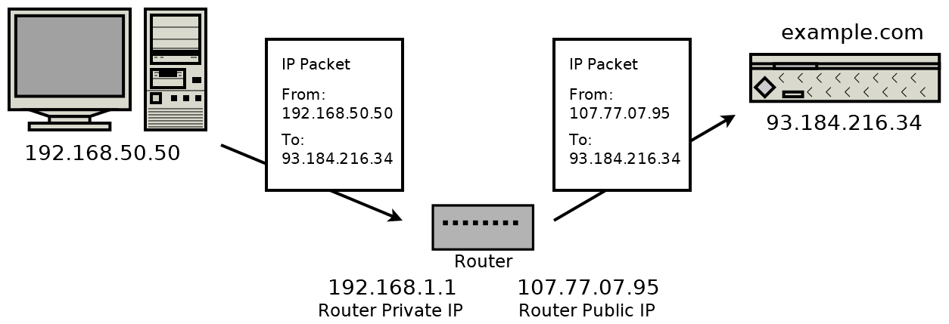
8. Local networks and address translation
Any traffic communicated to the internet must undergo address translation (Network Address Translation (NAT)) by the router. The router does this by modifying the source IP address from the original private LAN IP address to its public internet IP address.
Notes:
When a packet originates (bắt đầu) from a device on an IPv4 local network, it must undergo (qua) Network Address Translation (NAT) before being routed on the internet. A router that implements NAT remembers which local address a connection is established from.

Slide 44
9. Multicast, broadcast, and anycast
When a packet is routed from one sender to one receiver, it uses unicast addressing.
Broadcast addressing allows a single sender to address a packet to all recipients simultaneously.
Multicast is a one-to-many communication. Multicast involves some group management.
Anycast addressed packets are used to deliver a message to one recipient when you don’t care who that recipient is.
Notes:
0. So far, we've covered only routing with one sender and one receiver. While this is the most common situation, let's consider alternative cases too.
1. When a packet is routed from one sender to one receiver, it uses unicast addressing. This is the simplest and most common type of addressing. All of the protocols we deal with in this book use unicast addressing.
2. Broadcast addressing allows a single sender to address a packet to all recipients simultaneously. It is typically used to deliver a packet to every receiver on an entire subnet.
3. If a broadcast is a one-to-all communication, then multicast is a one-to-many communication. Multicast involves some group management, and a message is addressed and delivered to members of a group.
4. Anycast addressed packets are used to deliver a message to one recipient when you don't care who that recipient is. This is useful if you have several servers that provide the same functionality, and you simply want one of them (you don't care which) to handle your request.
---
IPv4 and lower network levels support local broadcast addressing. IPv4 provides some optional (but commonly implemented) support for multicasting.
IPv6 mandates multicasting support while providing additional features over IPv4's multicasting. Though IPv6 is not considered to broadcast, its multicasting functionality can essentially emulate it.
It's worth noting that these alternative addressing methods don't generally work over the broader internet. Imagine if one peer was able to broadcast a packet to every connected internet device. It would be a mess!
If you can use IP multicasting on your local network, though, it is worthwhile to implement it. Sending one IP level multicast conserves (tiết kiệm) bandwidth compared to sending the same unicast message multiple times.
However, multicasting is often done at the application level. That is, when the application wants to deliver the same message to several recipients, it sends the message multiple times – once to each recipient. In Chapter 3, An In-Depth Overview of TCP Connections, we build a chat room. This chat room could be said to use application-level multicasting, but it does not take advantage of IP multicasting.

Slide 45
Example: organization of air travel
ticket (purchase)
baggage (check)
gates (load)
runway takeoff
airplane routing
ticketing service
ticket (complain)
baggage (claim)
gates (unload)
runway landing
airplane routing
baggage service
gate service
runway service
routing service
airplane routing
layers: each layer implements a service
  via its own internal-layer actions
  relying on services provided by layer below

